Slide 1
Comparing XGBoost and Linear Regression for Predicting Median Value
Name: Yash Wadhwa
NUID: 002778382

Slide 2
INTRODUCTION
XGBoost (Extreme Gradient Boosting) is a powerful machine learning algorithm that uses a gradient boosting framework to train decision trees. It is commonly used for regression and classification problems and is known for its speed and accuracy. In this presentation, we will apply XGBoost algorithm on the Boston Housing dataset to predict the median value. We will compare the performance of XGBoost with linear regression using a suitable metric, Root Mean Squared Error (RMSE).

Slide 3
ML Algorithm: XGBoost
XGBoost is a powerful and efficient algorithm for building supervised learning models, particularly for regression and classification problems.
It uses a gradient boosting framework to improve the accuracy of models by iteratively adding weak learners to a strong model.
XGBoost is known for its speed and scalability, making it a popular choice for large datasets and time-sensitive applications.

Slide 4
Technical Approach
The Boston Housing dataset was loaded using pandas and a quick analysis was performed to check for missing values and correlation between the features.
The dataset was split into training and testing sets using the train_test_split function from sklearn.
XGBoost algorithm was applied on the training set and the median value of the testing set was predicted.
Linear regression was also applied on the training set and the median value of the testing set was predicted.
The Root Mean Squared Error (RMSE) was used to compare the performance of the two models and visualize the actual vs predicted values.

Slide 5
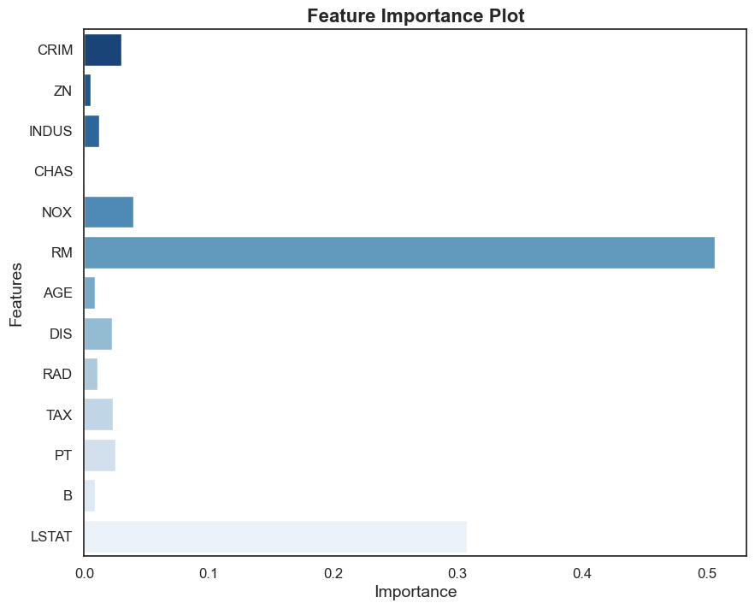
Output:
Feature Importance Plot

Slide 6
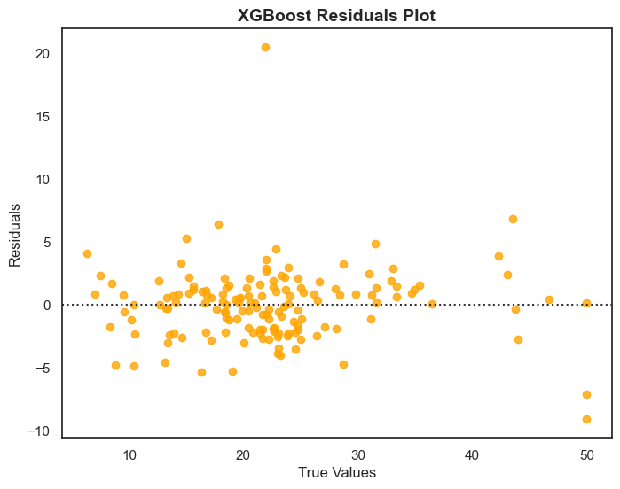
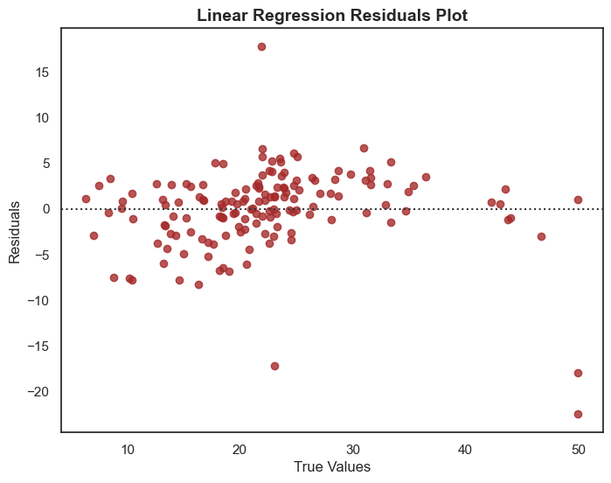
residual plots
XGBoost
Linear Regression

Slide 7
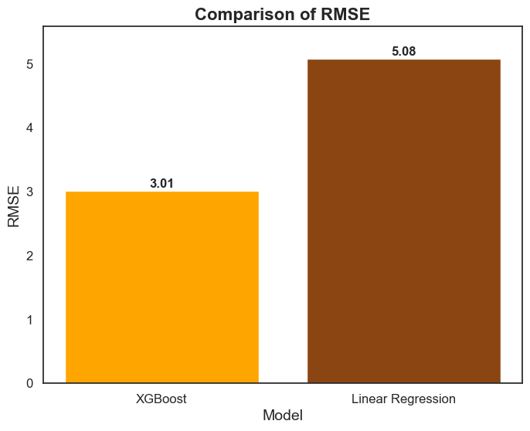
plots
RMSE Comparision:
XGBoost: 3.01
Linear Regression: 5.08

Slide 8
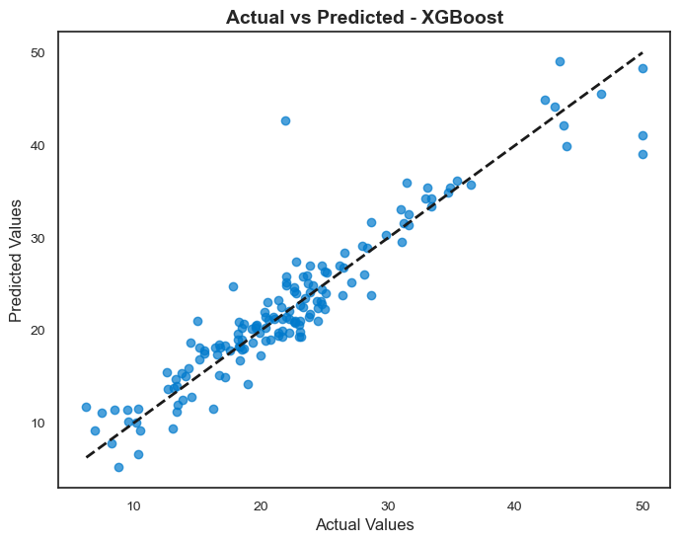
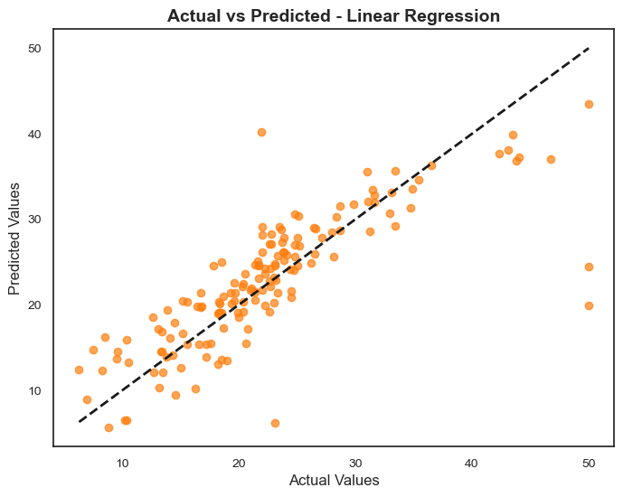
Actual vs Predicted

Slide 9
Conclusion
The RMSE values obtained after applying different algorithms showed that some models performed better than others in predicting the sales data.
The lowest RMSE values were obtained from the Prophet and XGBoost models, indicating their superior performance in accurately forecasting sales data.
Based on the RMSE analysis, we recommend using the Prophet or XGBoost models for predicting future sales data with the highest degree of accuracy.

Slide 10
Thank you!

